Slide 1
Chapter 14
Clustering
Unsupervised learning introduction
Where we learn form unlabeled data instead of label data.

Slide 2
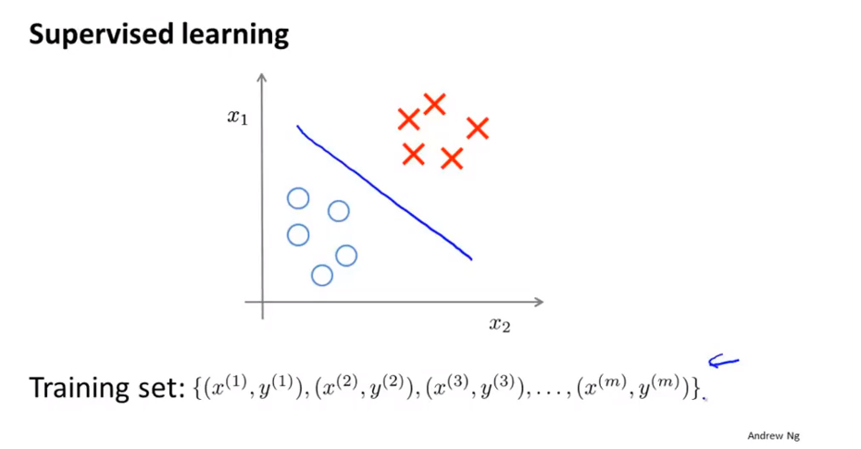
Chapter 14

Slide 3
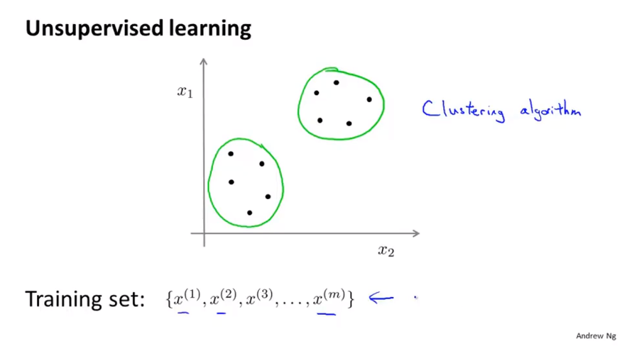
Chapter 14

Slide 4
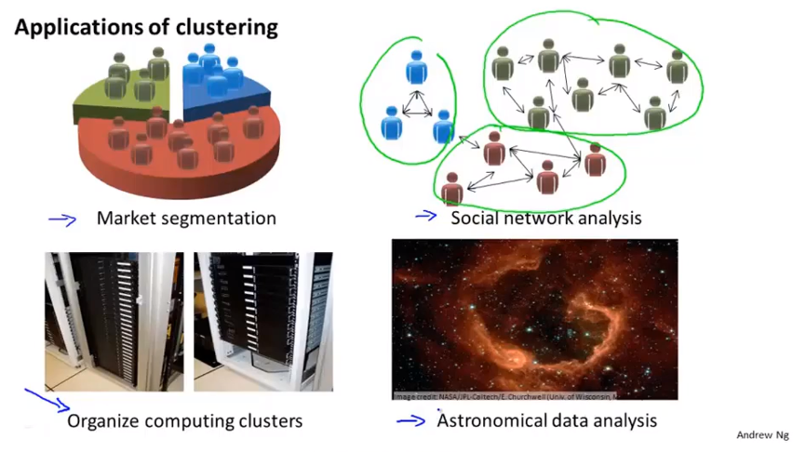
Chapter 14

Slide 5
Chapter 14
Clustering
K-means algorithm
In the clustering problem, we are given an unlabeled data set, and we would like to have an algorithm automatically group the data into coherent subsets, or into coherent clusters for us.
The K-means algorithm is by far the most popular, by far the most widely used clustering algorithm.

Slide 6
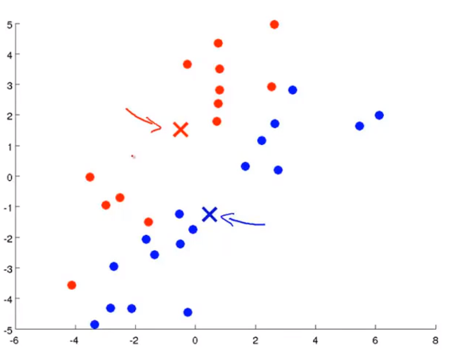
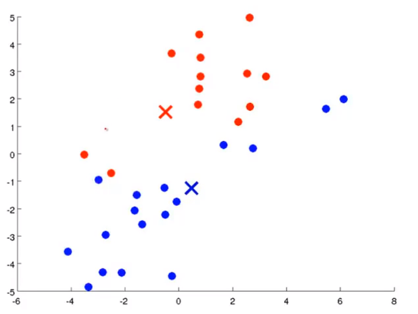
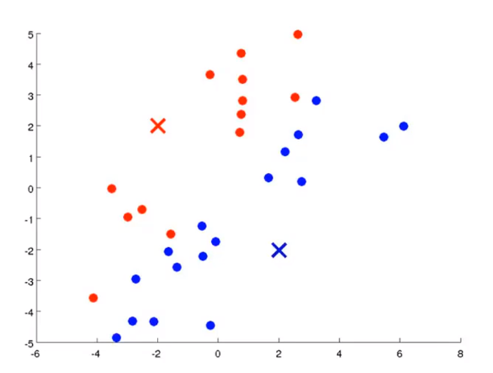
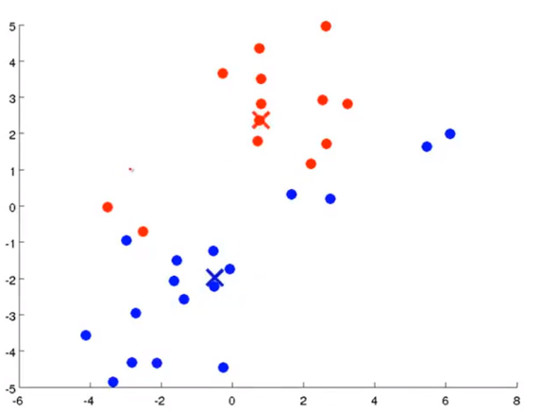
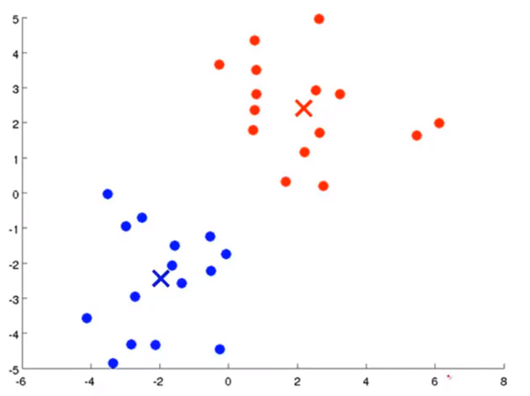
Chapter 14
K-Means is an iterative algorithm and it does two things. First is a cluster assignment step, and second is a move centroid step.
color
move centroid re-color
re-move centroid
stop iteration

Slide 7
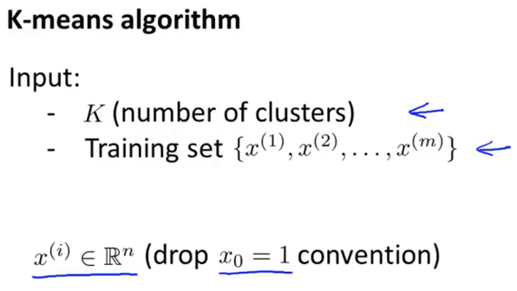
Chapter 14

Slide 8
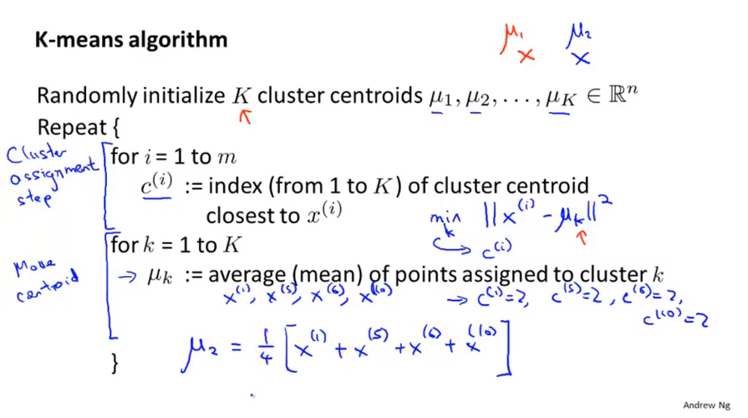
Chapter 14
If you have a cluster centroid with no point assigned to it, is you can just randomly reinitialize that cluster centroid, but it’s more common to just eliminate a cluster if somewhere during K means end up with no points and so assigned to that cluster centroid. That can happen, although in practice it happens not that often.

Slide 9
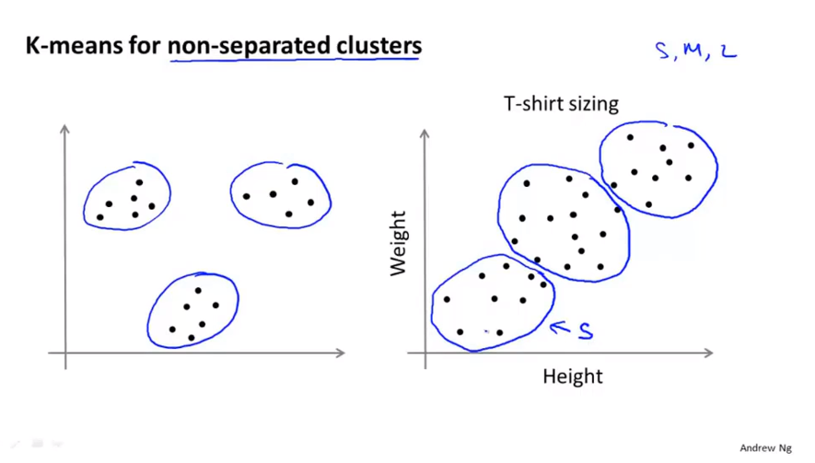
Chapter 14
And this is in fact kind of market segmentation where you use K-means to separate your market into three different segments.

Slide 10
Chapter 14
Clustering
Optimization objective

Slide 11
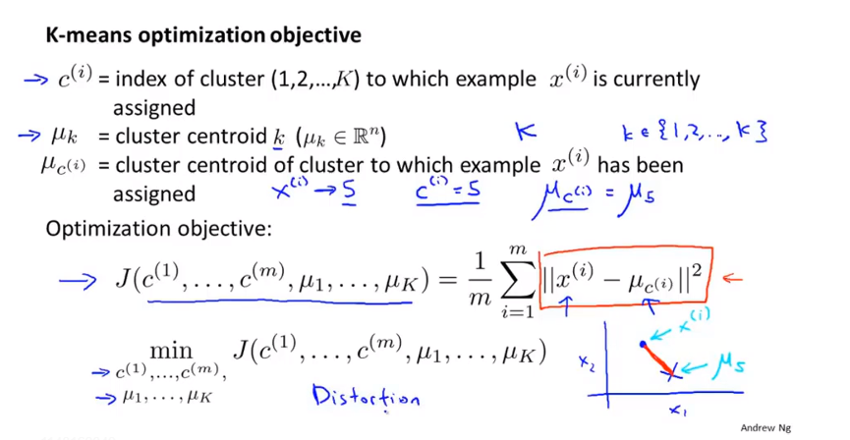
Chapter 14
K denote totally # of clusters
Distortion cost function or the distortion of the K-means algorithm

Slide 12
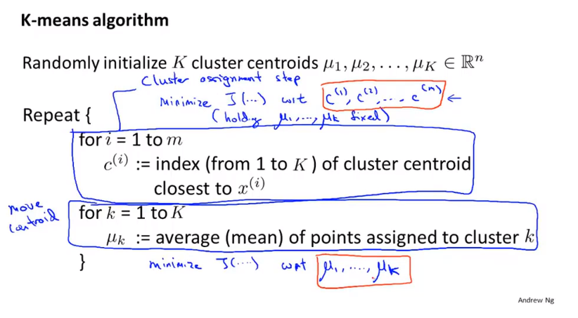
Chapter 14
What it does is that first minimizes J with respect to the variable C, and then minimize J with respect the variable mu and keeps on iterating.
We can use that to debug K-means and help me show that K-means is converging, and that it’s running properly.

Slide 13
Chapter 14
Clustering
Random initialization
How to make K-means avoid local optima as well.

Slide 14
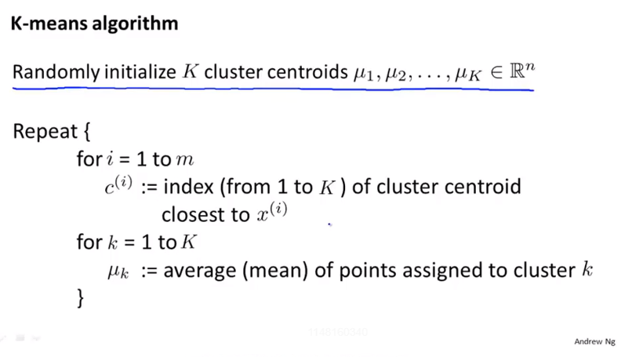
Chapter 14
How to randomly initialize K cluster centroids

Slide 15
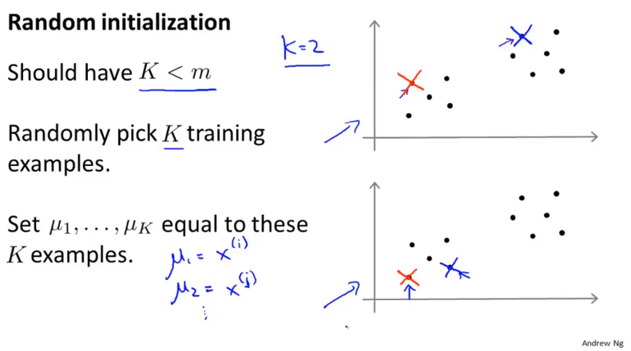
Chapter 14
Depending on the random initialization, K-means can end up at different solutions

Slide 16
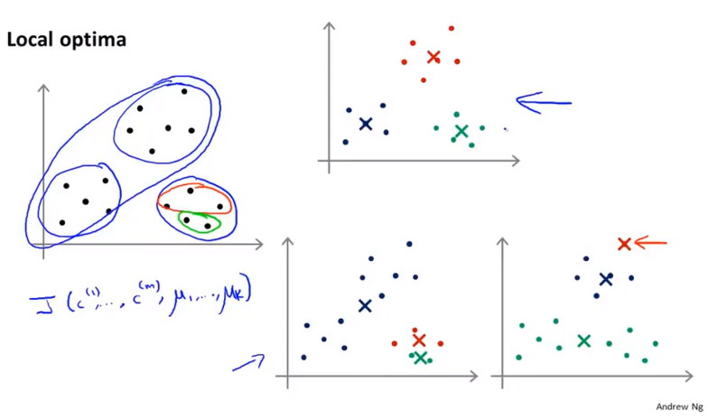
Chapter 14
K-means can actually end up at local optima.
Both the example here on the lower right correspond to different local optima of K-means.
What these local optima correspond to is really solution where K-means has gotten stuck to the local optima and bot do a very good job minimizing this distortion function J.

Slide 17
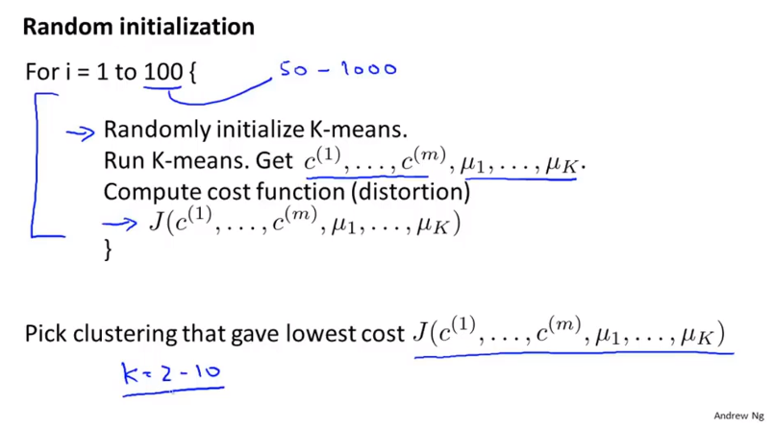
Chapter 14
Fairly typical number of times to run K-means would be something from 50 up to may be 1000.

Slide 18
Chapter 14
If K is very large, so if K is much greater than 10. Certainly if you were trying to find hundreds of clusters, then having multiple random initializations is less likely to make a huge difference and there is a much higher chance that your first random ionization will give you a pretty descent solution already and doing multiple random initializations will probably give you a slight better solution but maybe not that much.
In the regime of where you have a relatively small number of clusters, especially if you have, maybe 2 or 3 or 4 clusters that random initialization could make a huge difference in term of making sure you do a good job minimizing the distortion function and giving you a good clustering.
Maybe 5,6,7 clusters

Slide 19
Chapter 14
Clustering
Choosing the number of clusters
Although, the most common thing is actually to choose the number of the clusters by hand.

Slide 20
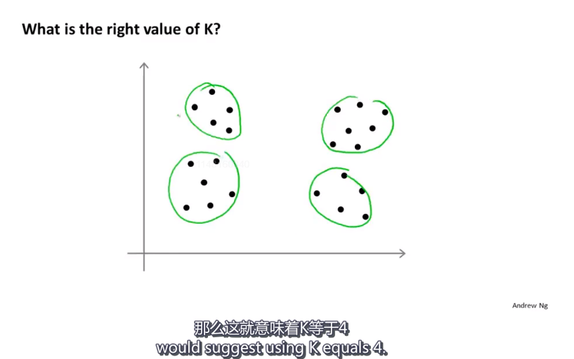
Chapter 14

Slide 21
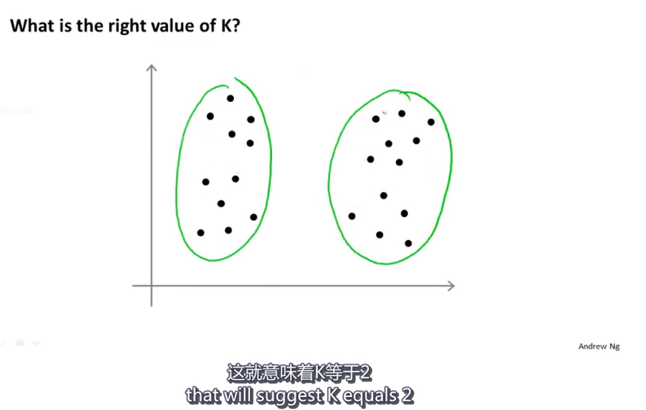
Chapter 14

Slide 22
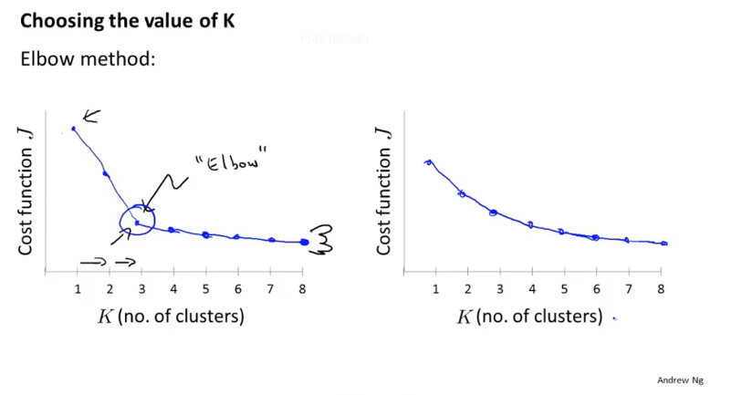
Chapter 14
What we’re going to do is vary K, which is the total number of clusters.
Quick summary of the elbow method is that is worth the shot but I wouldn’t necessarily have a very high expectation of it working for any particular problem.

Slide 23
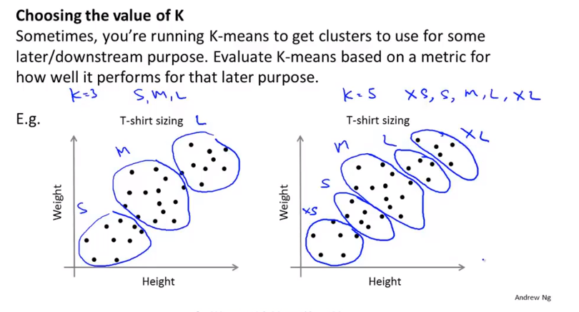
Chapter 14
And the T-shirt selling business, that might give you a way to decide, between three clusters versus five cluster.
…you could also, again use the evaluation metric of image compression to choose the number of clusters K.

Slide 24
Chapter 14
Summary.
For the most part, the number of clusters K is still chosen by hand by human input or human insight. One way to try to do is to use the Elbow Method, but I wouldn’t always expect that to work well, but I think the better way to think about how to choose the number of clusters is to ask, for what purpose are you running K-means ? And then to think, what is number of clusters K that serves that whatever later purpose that you actually run the K-means for.

